Slide 1
Unmasking Blockchain
Joseph Cutrono
Ultimate Software

Slide 2
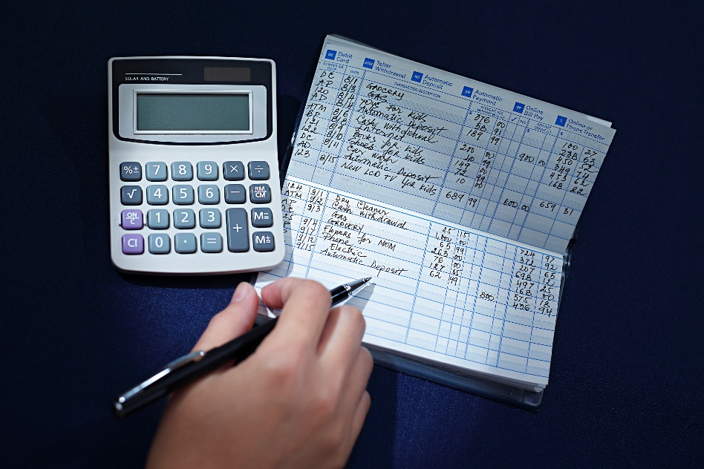
Terminology
Ledger
is the principal book or computer file for recording and totaling economic transactions measured in terms of a monetary unit of account by account type, with debits and credits in separate columns and a beginning monetary balance and ending monetary balance for each account.
Blockchain vs Distributed Ledger -> Xerox vs Copy
Hashing -> E365CD9C617713A54C6455F9D8998BA16E81E5078585F33A2DDCA8F03A3E8593

Slide 3
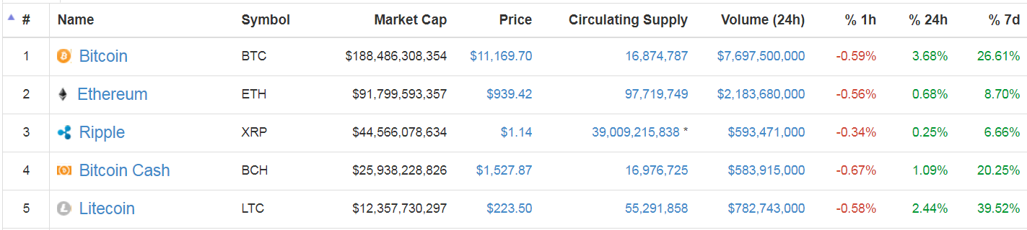
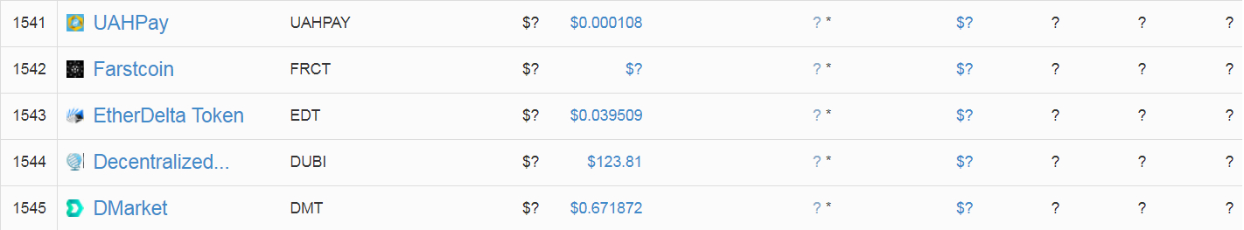
So which should I invest in… (smh)
~~~~~~~~~~~~~~~~~~~~~~~~~~~~~~~~~~~~~~~~~~~~~~~~~~~~~~~~~~~~~~~~~~

Slide 4
Example: Cryptocurrency
A naïve implementation

Slide 5
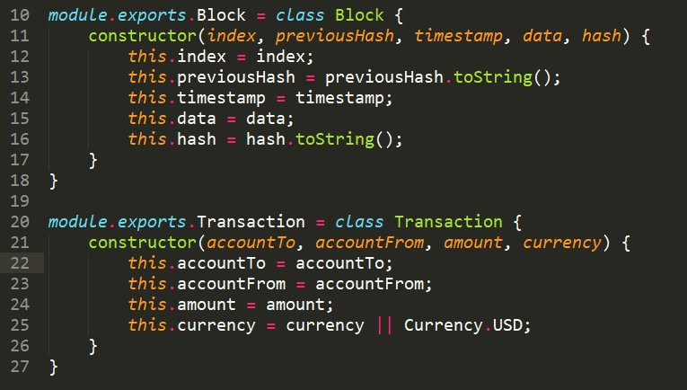
DDD approach for Cryptocurrency

Slide 6
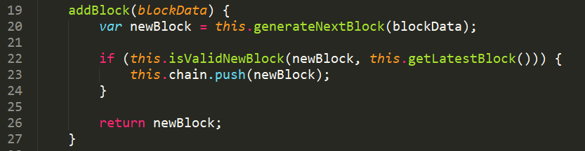
DDD approach for Cryptocurrency
addBlock – insert a new transaction

Slide 7
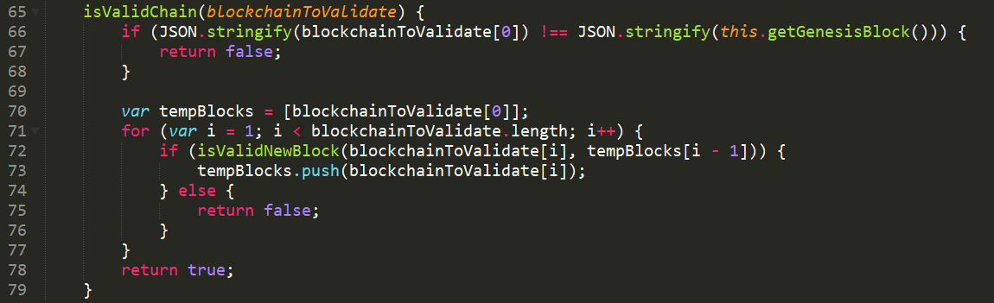
DDD approach for Cryptocurrency
validateChain – given the set of blocks, ensure we compute the same hash*
* Important to note we start at the beginning of the chain

Slide 8

3…2…1…ACTION

Slide 9
Public API’s
Blockchain
Coinbase
Task description
Task description
Task description
Task description
Task description
Task description
Task description
Ethereum
Task description
Task description
IBM
Task description
Task description

Slide 10
API’s
First bullet point here
Second bullet point here
Third bullet point here
Class | Group 1 | Group 2
Class 1 | 82 | 95
Class 2 | 76 | 88
Class 3 | 84 | 90

Slide 11
Add a Slide Title - 2

Slide 13
Add a Slide Title - 4

Slide 14
Add a Slide Title - 5

